Slide 1
WELCOME
phxicc.org & usd21.org facebook.com/phxicc

Slide 2
Communion

Slide 3
Contribution

Slide 4
Announcements
Wednesday 9/25 7:30pm - Congregational First Principles
There will be a quiz on "The Word of God" and "Discipleship" studies & the four memory verses:
From Session 2 - John 8:31-32 and Philippians 4:13
From Session 3 - Mark 1:17 and John 13:34-35)
Friday Oct 4th - Sunday Oct 6th : Marriage Retreat - "The Vow.
!VERY IMPORTANT REGARDING HOTEL!
Call the Poco Diablo Resort Monday (928-282-7333) and ask for the ONSITE RESERVATION. They WILL NOT Charge your card UNTIL you checkout! Sign up in BACK!
We now have "The Vow" invitations. Please pick-up 5 per married member.
Sunday October 27th Bring Your Neighbor Day - "Back To The Bible"
Please pick up 10 invitations in back! BBQ and Talent Show to follow!
Contact Jeremy Ciaramella at 541-579-5795 if you are interested in performing for the show.

Slide 5
Announcements
Saturday 9/21 8:15AM Tagging at University and Rural
Wear your MERCY shirt!
All donations go towards Special Missions Contribution Sunday November 24th!
Friday Oct. 11th 9AM – Sunday October 13th, City of Angels Campus Retreat at Camp Whittle, Big Bear. “Elevate: Keep Rising To The Top” ($40)
Friday Oct. 11th 8:30PM – Sunday October 13th, City of Angels Singles Retreat at Catalina Island($181.00)

Slide 6
~Fellowship Break~

Slide 7
First Principles 2013

Slide 8
Discipleship: Review
REVIEW
Where will we start when there is no faith in Christ?
John. Why? It is an eyewitness account of the scriptures.
Zealous young disciple, Bob. Bob met "that Christian to be" Ralph.
Comes to church...wants to study...no faith? John. Faith in Jesus? Seeking God.
Calling him to seek God, and if you seek God, you’ll be blessed.
The next study after seeking God? The Word.
If they come to a conviction that the Word of God is to be obeyed, when they hit the challenging studies...they say, "I am going to go by the Word, not my feelings, not my traditions or experiences.”
Do NOT skip these studies! (Seeking God and the Word!)
Need to catch up? Check out phxicc.org

Slide 9
Discipleship: Introduction
Don’t be gun shy on this study. Don't really lay it out.
Enthusiastic - literally in the Greek - "God in us!" Not enthusiastic, implications right there! Boring!? Sin.
Built a foundation, a heart to seek God, a conviction to go by the word of God and obey it.
This is such an important study. Do the study well, over baptism, over denomination thinking.
Set the time, do not allow too much time between studies. Gauge it to the person. Every day, once a week, gauge the heart.
With every study, get the LORD moving, start with a word of prayer.
During the study itself, trade off in reading the scriptures.
Helps the non-Christian, "I can understand the bible."
Some are poisoned, thinking bible is not understandable.
Why trading-off in the reading is so important. Romans 10:17

Slide 10
Discipleship: Introduction
Remember – you have your pad of paper, writing the scriptures, and a few bullet points of what they say. Give it to Ralph after.
Goal is to Keep these studies a little bit under an hour. (Except Light and Darkness/Cross)
Matthew 28 - set up this scripture.
These are the last words of Jesus.
Last words are super important.

Slide 11
Introduction: Matthew 28:18-20
What is a Christian? What is a disciple? What is the difference? (Write this down.)
What does this scripture say to you?
Jesus wants the whole world to know about him.
What does Jesus want everyone to become?
Become a disciple.
Really important get them wrestling with the terminology, "disciple."
Ask 10 people, what does it mean to be a Christian? 10 different responses.
How many times does the word "Christian" appear in the bible?
How many times does the word "Disciple" appear?
Look at the biblical connection between these words.
First time, going to the Gentiles. Up until this time, was focused only on Jews.

Slide 12
Acts 11:19-26
So huge an impact, they got a nickname. “Christian” “Little Christ.”
First seven years of Christianity..."disciple" is the term. Only when a gentile city, "Christian." Derogatory.
Christian appears three times. Disciple 270 times.
Get a hold of. What does it really mean to be saved. Understand, saved = Christian.
This passage, "Disciples" were first called Christians.
Saved = Christian = Disciple.
The whole rest of the study is going to come down to this.
10 people, 10 answers, now we are going to let Jesus define what a disciple is.
If you do not set this up, impact f the study is totally gone.
Jesus wants everyone to be a disciple.
Disciples first called Christian's Antioch. Disciple = Christian.
Now let's let Jesus define what a true Christian is. Look at the passages where Jesus defines what his DISCIPLE is to be.

Slide 13
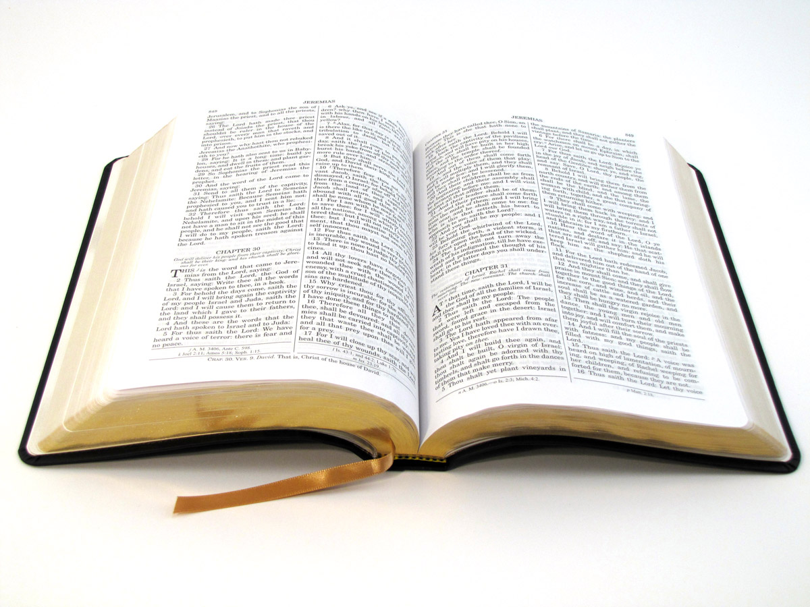
Let’s have Jesus define disciple, thus defining who is a true Christian.

Slide 14
1. Mark 1:14-18
A. Calling of the first disciples
B. Come follow me (Christ)
C. Fishers of men – Jesus gave these first disciples the real purpose for living
D. Immediately

Slide 15
2. Luke 9:23-26
A. If any man...
B. Deny self. Notice Christ in the garden (Matthew 26:36-39, “Not my will, but your will.”) Do not give in to moods.
C. Carry the cross – daily
D. Gain world ... forfeit soul. Lose your life for Jesus ... save it

Slide 16
3. Luke 14:25-33
A. If any man...
B. Count the cost (v. 28-30)
C. Consider the alternatives (v. 31-32)
D. Love Christ more than any person (v. 26)
E. Persecutions (v. 27)
F. Everything, not just anything (v. 33)

Slide 17
4. Luke 11:1-4
A. Must learn to pray – disciples saw the strength Jesus received from the Father
B. Daily personal relationship with God (v. 3); daily prayer

Slide 18
5. John 13:34-35
A. Love one another
B. Be an active part of the fellowship

Slide 19
6. Matthew 28:18-20
A. Command – make disciples (given to all)
B. Who is a candidate for baptism? A person who makes the decision to be a disciple
C. You need someone to disciple you to maturity in Christ
D. This is the only way to save the world!

Slide 20
Jesus’ Vision
YEAR Preacher Disciple
1 365 2
2 730 4
3 1095 8
13 4745 8192
32 11,680 Over 5 billion

Slide 21
Matthew 28:18-20 (Continued)
Conclusion Questions:
Am I a disciple?
Am I a Christian?
Am I saved?
What do I need to do to become a disciple?

Slide 22
Next Sessions Quiz! (Wednesday 9/25)
Session 2 scripture memory (Word of God)
John 8:31-32
Philippians 4:13
Session 3 scripture memory (Discipleship)
Mark 1:17
John 13:34-35
Know the scriptures and bullet points for both the “Word of God” and “Discipleship”

