Slide 1
WELCOME
phxicc.org & usd21.org facebook.com/phxicc

Slide 2
Upcoming Events: This Coming Week
Sunday 9/14 10:00AM
Congregational Service SDA
Wednesday 9/17 7:30PM
Women’s Midweek & First Principles Session 10 – The Church
Saturday 9/20 9AM (Check for your assigned time)
RED Cross, Donating blood. Come and show support!
Wear your MERCY shirt!
Sunday 9/21 10:00AM
Congregational Service SDA

Slide 3
Upcoming Events: Later This Month
Wednesday 9/24
First Principles FINAL EXAM
Saturday 9/27
Tagging for November Special Missions (9A-1P)
Sunday 9/28
House Church Services!

Slide 4
Upcoming Events: October & November
October
Sat/Sun October 4th & 5th
CAICC Soar Singles Retreat in Palm Desert
Sunday October 12th BYND “Crazy Hat Sunday”
1st & 2nd prizes for the best hats & best carved pumpkins. Harvest pot-luck to follow!
Friday/Sat October 17th & 18th
Married’s Retreat in Fountain Hills at the Lexington.
November
Saturday November 8th
Special Missions Trash-a-Thon (9-1pm)
Sunday November 16th
6x Missions contribution

Slide 5
Course Reminders
Acts outline will be due: Wed 9/24 (Same day as Final)
Know the 66 books of the bible
Know the two scriptures where the types Miraculous Gifts are discussed.
Know the three types of “Laying on of Hands”
Know the purpose of the miraculous gifts

Slide 6
Baptism With The Holy Spirit Session 8: QUIZ #1-#4
What are the five characteristics of the Baptism With The Holy Spirit?
Write out 1 John 1:9
What are the three measures of the Holy Spirit?
What are the three baptisms in the New Testament?

Slide 7
Baptism With The Holy Spirit Session 8: QUIZ #5
#5 The “One Baptism” (Eph 4:4-6)
Note which scripture(s) clarify each point: (.25 each)
This verse crystallizes John’s baptism passed when the new covenant began:
The baptism of the Holy Spirit prophecy/promise fulfilled in these two chapters (not commanded!):
This scripture clarifies that baptism in water in the name of Jesus Christ for the forgiveness of sins is Jesus’ self-perpetuating command:
Peter was present for all 3 baptisms. He wrote in this scripture in 64AD that baptism in the name of Jesus Christ saves you & that the flood during Noah’s time symbolized baptism which saved a “few”:

Slide 8
Baptism With The Holy Spirit Session 8: BONUS & Extra Credit
BONUS
In the past seven days have you been in (+.5) or led a (+1), bible study with a friend? (up to 2pts)
Did you attend the leaders meeting where the Persecution study was taught? (+1)
Extra Credit (.5 points each today)
I'm signed-up to donate blood on the 20th!
Subscribed to youtube.com/phxicc
Following twitter.com/phxicc

Slide 9
Baptism With The Holy Spirit Answer Key #1
#1 What are the five characteristics of the Baptism With The Holy Spirit?
Promised (not a command) Acts 1:4-5*
Predicted (prophesied)
Came without warning (not praying for it)
Languages.
Purpose: to usher in the Kingdom with power (Mark 9:1, Acts 1:8)*
* Scriptures are not necessary for correct answer.

Slide 10
Baptism With The Holy Spirit Answer Key #2 & #3
#2 Write out 1 John 1:9
“If we confess our sins, he is faithful and just and will forgive us our sins and purify us from all unrighteousness”
#3 What are the three measures of the Holy Spirit?
The Indwelling of the Holy Spirit
The Baptism with the Holy Spirit
The Miraculous gifts of the Holy Spirit

Slide 11
Baptism With The Holy Spirit Answer Key #4
#4 What are the three baptisms in the New Testament?
The Baptism of John
The Baptism with the Holy Spirit
The Baptism in the name of Jesus Christ for the forgiveness of sins and the gift of the (Indwelling) Holy Spirit.

Slide 12
Baptism With The Holy Spirit Answer Key #5
#5 The “One Baptism” (Eph 4:4-6)
Note which scripture(s) clarify each point: (.25 each)
This verse crystallizes John’s baptism passed when the new covenant began: Acts 19:1-5
The baptism of the Holy Spirit prophecy/promise fulfilled in these two chapters (not commanded!): Acts 2 & Acts 10
This scripture clarifies that baptism in water in the name of Jesus Christ for the forgiveness of sins is Jesus’ self-perpetuating command: Matthew 28:18-20
Peter was present for all 3 baptisms. He wrote in this scripture in 64AD that baptism in the name of Jesus Christ saves you & that the flood during Noah’s time symbolized baptism which saved a “few”: 1 Peter 3:18-21

Slide 13
Baptism With The Holy Spirit BONUS & Extra Credit
BONUS
In the past seven days have you been in (+.5) or led a (+1), bible study with a friend? (up to 2pts)
Did you attend the leaders meeting where the Persecution study was taught? (+1)
Extra Credit (.5 points each)
I'm signed-up to donate blood on the 20th!
Subscribed to youtube.com/phxicc
Following twitter.com/phxicc

Slide 14
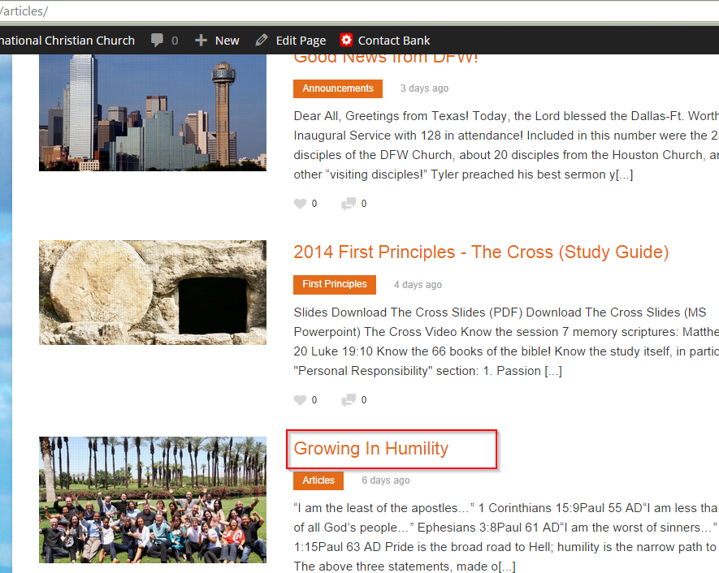
Comments at phxicc.org: Additional Extra Credit (up to 3 points)
Read and then make a 1 paragraph comment for any bulletin article at phxicc.org.

Slide 15
First Principles 2014 Session 9: “The Miraculous Gifts of the Holy Spirit”

Slide 16
The Miraculous Gifts of The Holy Spirit Session 9: Overview
Types of Miraculous Gifts
1 Corinthians 12:8-10
Mark 16:16-18
The three types of “Laying on of Hands”
Blessing
Healing
Passing on the Gifts
General Observations

Slide 17
Types of Miraculous Gifts A. 1 Corinthians 12:8-10
1. Wisdom
2. Knowledge
3. Faith
4. Healing
5. Miracles
6. Prophecy
7. Distinguishing Spirits
8. Tongues
9. Interpretation

Slide 18
Types of Miraculous Gifts B. Mark 16:16-18
Some will be able to:
Drink poison and not die
Be bitten by snakes and not die (Acts 28:5)

Slide 19
The three types of “Laying on of Hands” A. Blessing (Acts 13:3)
Acts 13:2-3 NIV84
While they were worshiping the Lord and fasting, the Holy Spirit said, "Set apart for me Barnabas and Saul for the work to which I have called them." So after they had fasted and prayed, they placed their hands on them and sent them off.

Slide 20
The three types of “Laying on of Hands” B. Healing
Ananias heals Paul’s blindness. (Acts 9:17-18)
2. Paul heals Publius’ father on Malta. (Acts 28:8)

Slide 21
The three types of “Laying on of Hands” C. Passing on the Gifts
1. Apostles pass on the gifts. (Acts 8:18)
2. These people could not pass on the gifts they received.
a. Acts 6:1-8 Context is the choosing of “The Seven”. This is the first occasion that the gifts were passed. Stephen immediately starts to perform miraculous signs among the people with God’s power. (v. 8)

Slide 22
The three types of “Laying on of Hands” C. Passing on the Gifts: Phillip of Acts 6:1-8
b. Acts 8:1-25 Context is after Stephen’s martyrdom. Great persecution breaks out. Many leave, but apostles (Acts 8:1) stay in Jerusalem. Philip, one of “The Seven” who had received the gifts in Acts 6:1-8, goes to Samaria.
He [Philip] performs many miraculous signs and healings to get people to believe (v. 12), including Simon the Sorcerer (v. 13), and they are baptized. (They became Christians and thus receive the forgiveness of sins and the gift (indwelling) of the Holy Spirit. Acts 2:38)
When apostles come to Samaria, Simon saw the Spirit’s gifts were only given by the apostles’ laying on of hands and offers them money for this ability. (Acts 8:18)
CRITICAL Note: Simon didn’t ask Philip for the gifts because Philip could not pass them on. Simon is rebuked for having the wrong motivation.

Slide 23
The three types of “Laying on of Hands” C. Passing on the Gifts: Disciples in Ephesus Acts 19:1-6
c. Acts 19:1-6 Paul finds disciples in Ephesus who didn’t know what the Holy Spirit was because they had only received John’s baptism of repentance.
Then they were baptized into the name of Jesus Christ to receive the forgiveness of their sins and the indwelling of the Holy Spirit. (v.5)
Then they receive the miraculous gifts of prophecy and speaking in tongues by the laying on of Paul’s hands. (v.6) Paul is an apostle.

Slide 24
3. General Observations
Apostles were able to pass on the gifts because they were apostles.
The Apostles possessed the ability to perform miracles even during the ministry of Christ. (Luke 9:1)
This ability to pass and perform the gifts was not given at Pentecost .

Slide 25
3. General Observations B. 1 Corinthians 12 and 14 are not the directives, but correctives
B. 1 Corinthians 12 and 14 are not the directives on how to receive tongues (the church there had already received them), but rather the correctives on how to use them because everyone was speaking at the same time and misusing the tongues.
1 Corinthians 12:28-30 shows that tongues as a gift were not given to everyone in the church.
Thus the concept of a “Pentecostal church” (every member speaking in tongues) is contrary to Scripture.

Slide 26
3. General Observations C. 1 Cor 13:8-10 “Perfection”–Canonization of Bible
C. 1 Corinthians 13:8-10 “Perfection” here could not mean the coming of Christ because it is in the neuter gender in Greek, not the masculine gender.
“Perfection” – teleios (τέλειος)
brought to its end, finished
wanting nothing necessary to completeness
When perfection comes probably refers to the canonization of the Bible sometime after the first century.
At that time, all the miraculous gifts would be gone because all the apostles and those to whom they passed the gifts would have died.

Slide 27
3. General Observations D. The Purpose of the gifts from 1 Cor 14:20-22
D. The purpose of the miraculous gifts from 1 Corinthians 14:20-22:
To get non-believers to believe (tongues were only to be used to bring non-believers to faith.)
To edify the Christians and strengthen their faith.
Now the Bible fulfills these needs – thus the church today does not need apostles or miraculous gifts.

Slide 28
3. General Observations E. 2 Thess 2:9-12 shows there can be miracles by Satan today
E. 2 Thessalonians 2:9-12 shows there can be miracles by Satan today.
Satan’s purpose is to deceive people about the truth, so they will not be saved.

Slide 29
3. General Observations F. Speaking in “tongues” (Ecstatic Utterances, Pagan in Origin)
F. Speaking in “tongues” pagan in origin and common in many religions.
These are also called “ecstatic utterances” (technically “glossolalia” – non-understandable sounds and fragments of speech.)
Glossolalia is a phenomenon recorded in pagan religions throughout ancient history.
There is an 1100 BC account about “Winamon,” a worshipper of the Egyptian God Amon. The account says that while he was worshipping Amon in the temple he became frenzied and spoke in some ecstatic language all night.

Slide 30
3. General Observations F. Speaking in “tongues” (Ecstatic Utterances, Pagan in Origin)
Plato reported ecstatic utterances in roughly the 5th century BC. In the accounts Plato reported the speaker had no control over his mental faculties, and was allegedly under the control of a god.
In 17-19 BC, Virgil mentions a Sibyline priestess who would go into an ecstatic state and “speak in tongues” (ecstatic utterances) as she united with Apollo’s spirit.
The Pythoness, the Oracle at Delphi.
This Greek word, “Puthon” where we get “Python” is in fact the same word used for the “spirit” (Acts 16:16) that possessed the woman in Acts 16 that followed the Apostle Paul and his companion Silas shouting “These men are servants of the Most High God, who are telling you the way to be saved.” Acts 16:17
About 420 BC John Chrysostom (Bishop of Constantinople) recorded this:
“This same pythoness is said, being a female, to sit at times upon the tripod of Apollo astride, and thus the evil spirit ascending from beneath and entering the lower part of her body fills the woman with madness. And she with dishevelled hair begins to foam at the mouth, and thus being in a frenzy, to utter the words of her madness.”

Slide 31
3. General Observations F. Speaking in “tongues” is common in many religions
F. Speaking in “tongues” is common in many religions (Mormon, Catholic, Islam, etc.), because religion gets dried and staid.
A little history starting in the 1800’s to 1850’s “Two step” theology.
Step 1, get part of it (“Holiness”) at the cross
Step 2, get the next work of grace at the point of (your) dedication.
This Led to the “Holiness Theology” where you’d reach a “second point of grace.”
Origins in Charles Wesley’s teachings (“Methodist”)
Wesley taught “a second operation of dedication, commitment, whatever it may be, that takes the believer into this higher plane.”

Slide 32
3. General Observations F. Speaking in “tongues” is common in many religions
By the end of 1800s people began identifying this second work of grace with “the baptism of the Holy Spirit.“
By the late 1890s this concept of Baptism With The Holy Spirit being confirmed by “speaking in tongues” (“ecstatic utterances, aka “glossalalia”)
January 1st, 1901 - A man named Charles Parnham of the Bethel Bible Institute in Topeka, Kansas, had a watch-night service where they were praying that the Holy Spirit would descend on them and they would speak in tongues. Just after midnight Agness Osmond began to throw her head back and speak in what they thought was Chinese, and that became the birth of the modern Pentecostal movement.
The modern Pentecostal movement was characterized by the belief that baptism of the Holy Spirit was after salvation, that baptism of the Holy Spirit was signified always by speaking in tongues, that every believer needed to be baptized by the Holy Spirit and to speak in tongues (which was a sign of higher spirituality).

Slide 33
3. General Observations F. Speaking in “tongues” is common in many religions
We learned from the baptism with the H.S. study there is now only one baptism - as taught by Eph 4 – which was written ~68AD. Thus, all other “baptisms” (plural) were invalidated. John’s in Acts 19 and the Baptism with the H.S. serving it’s purpose and ushering the kingdom for Jew (Acts 2) and Gentile (Acts 10).
1 Cor 14:8-12 “Undoubtedly there are all sorts of languages in the world, yet none of them is without meaning.”

Slide 34
3. General Observations G. Filled with the Spirit without speaking in tongues.
G. A person can be filled with the Spirit without speaking in tongues. (Ephesians 5:18-20)
Contradicts the notion of everyone “speaking in tongues” as a sign they have the Holy Spirit.

Slide 35
3. General Observations H. Jesus never “spoke in tongues”
H. Jesus never spoke in tongues and he was accorded the full-measure of the Spirit. (John 3:34-36)

Slide 36
Quiz Preparation & Coursework
Acts outline is due Wednesday 9/24
Has the weight of a quiz. (5 points)
Three short points each chapter.
Typed, emailed (jeremy@usd21.org) or printed.
Know the 66 books of the bible
Know the scriptures where the types Miraculous Gifts are discussed.
1 Corinthians 12:8-10
Mark 16:16-18
Know the three types of “Laying on of Hands”
Blessing
Healing
Passing on the Gifts
Know the purpose of the miraculous gifts
To get non-believers to believe (tongues were only to be used to bring non-believers to faith.)
To edify the Christians and strengthen their faith.
Now the Bible fulfills these needs – thus the church today does not need apostles or miraculous gifts.

